Slide 1
Product Fact Book
Bravuris 3^{HM}
Well balanced with a plus in mileage
START

Slide 2
Brand
Marketing
Technology
Market launch
Barum – Good tyres. Good deal.
Brand statement
Good quality for a fair price.
Brand position
Barum tyres have been systematically designed for high mileage performance and
therefore offer an attractive balance of price and performance.
Reason
Attractive price
Balanced performance
Benefits
Smart shoppers: focus on value for money
Basic consumer insight

Slide 3
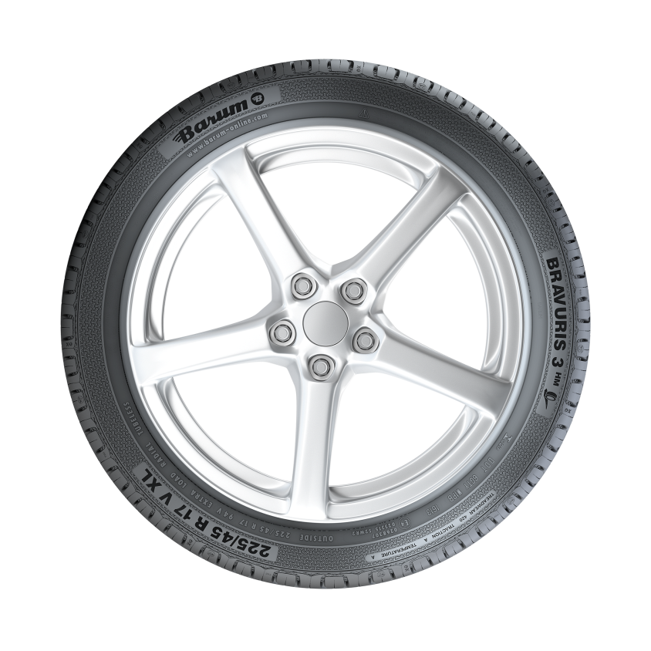
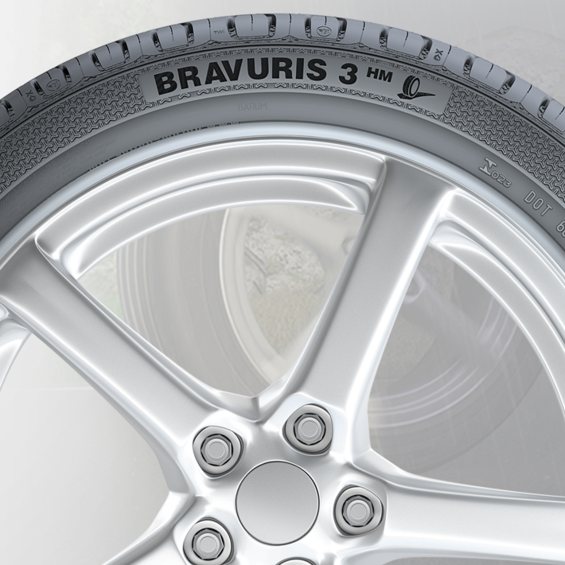
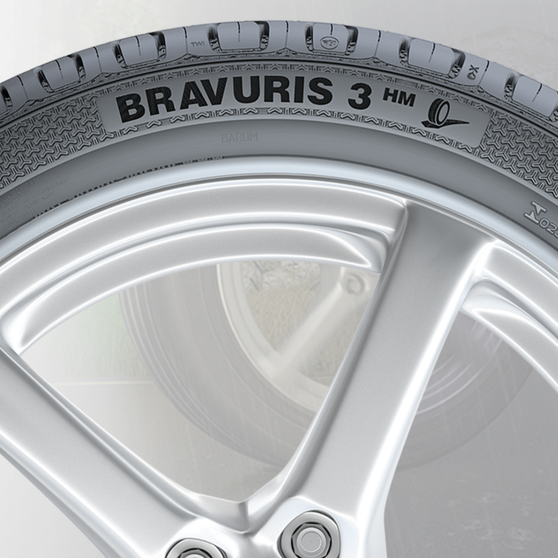
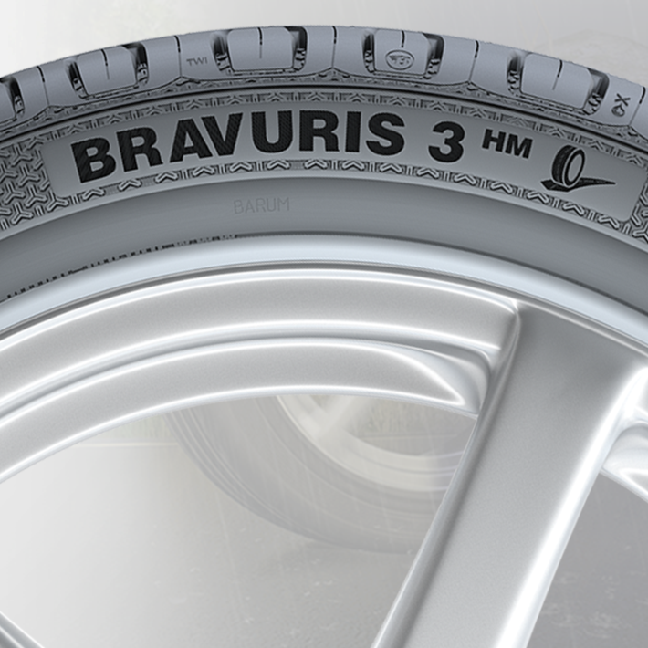
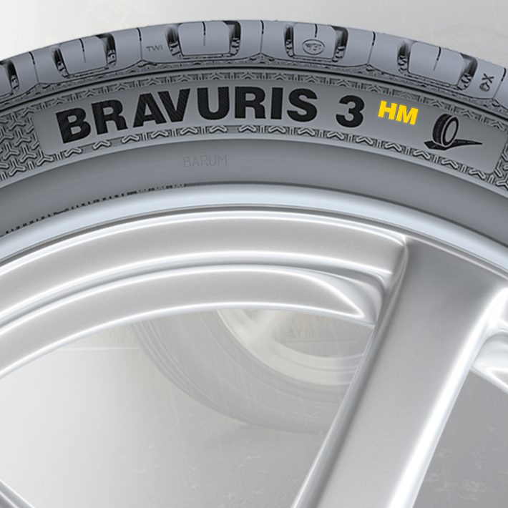
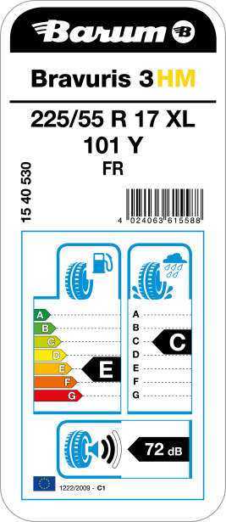
The mileage promise
Marketing
Technology
Market launch
The plus in mileage is a key selling point for dealers. For this reason, this performance characteristic is given special emphasis for the Bravuris 3^{HM} using the following measures:
1. We use ‘HM’ as an abbreviation of ‘high mileage’ and include it in the product name: Bravuris 3^{HM}.
Advantages:
The promise of higher mileage is directly
connected to the product name.

Slide 4
Feature – Effect – Benefit
Marketing
Technology
Market launch
Feature
Mileage
Wide and flat contour with well balanced rib structure
High number of pitches and numerous sipes
Handling
Closed shoulders with macro-blocks (outside) and sub depth elements for shoulder blocks (inside)
Wide center and intermediate ribs
Wet breaking
High number of grip edges due to sipes and a high pitch count number
State-of-the-art compound
Effect
Mileage
Reduced and equal pressure distribution in contact patch
Reduced block deformation and slip in contact patch
Handling
High lateral stiffness enables good transmission of side forces
Transference of side forces supported especially for lower wheel angles
Wet breaking
Grip edges penetrate the water film in wet driving conditions, improving road surface contact
Improved road grip on wet surfaces
Benefit
Mileage
Higher mileage due to reduced wear rate and even wear shape
Higher mileage due to reduced friction energy
Handling
Precise handling and safe driving on winding roads
Good directional stability
Wet breaking
Short wet braking distances

Slide 5
Performance diagram
Marketing
Technology
Market launch
Aquaplaning 97%
Rolling resistance
110%
Wet handling 102%
Noise 102%
Wet braking 107%
Bravuris 2
Bravuris 3^{HM}
Mileage 116%
Dry handling 101%
Dry braking 99%

Slide 6
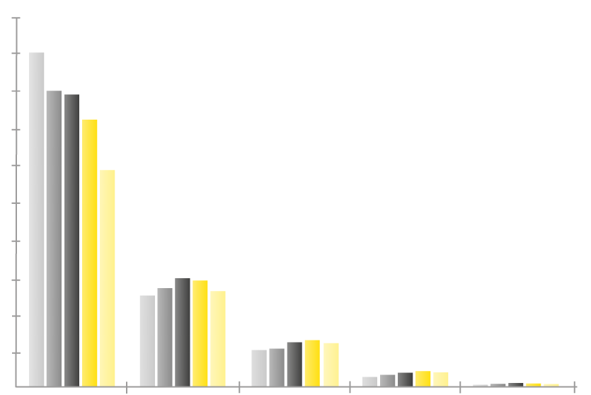
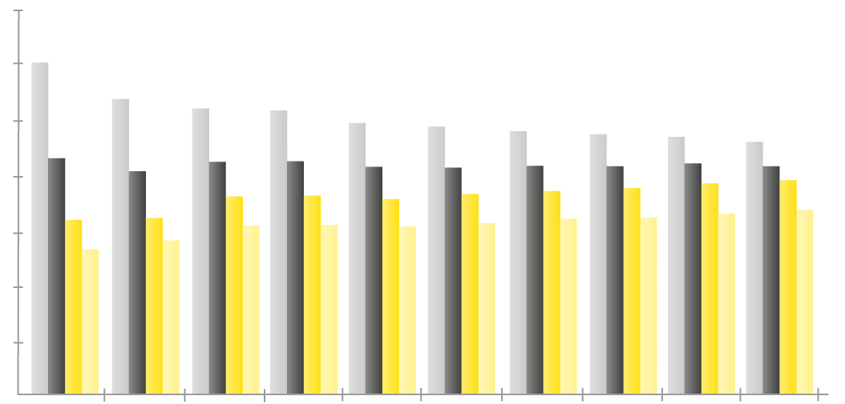
Market development in Europe
Marketing
Technology
Market launch
Market development by inch
Market development by speed symbol
100,000,000
90,000,000
80,000,000
70,000,000
60,000,000
50,000,000
40,000,000
30,000,000
20,000,000
10,000,000
0
2008
2009
2010
2011
2012
70,000,000
60,000,000
50,000,000
40,000,000
30,000,000
20,000,000
10,000,000
0
–10%
Speed symbols R, S, T
Speed symbol H
Speed symbol V
Speed symbols W, Y, Z
–2.9%
–0.3%
+2.3%
+1%
+2.7%
+5%
+7%
+13%
<= 15 inch = 16 inch = 17 inch = 18 inch >= 19 inch
2008
2009
2010
2011
2012
2013*
2014*
2015*
2016*
2017*
Source: ERMC data
Source: Marketing Intelligence Continental AG * = prediction
The positive development of the segment >= 17 inch and speed symbols V, W, Y and Z continues

Slide 7
Product range
Marketing
Technology
Market launch
Serie 50
205/55 R 16 91 V TL
185/55 R 15 82 H TL
225/55 R 17 101 Y TL XL FR
215/55 R 16 93 V TL
225/50 R 17 Y XL FR
185/55 R 14 80 H TL
225/55 R 16 95 V TL
195/55 R16 87 V TL
195/55 R 16 87 H TL
185/55 R 15 82 V TL
215/55 R 16 93 Y TL
205/55 R 16 91 H TL
195/55 R 15 85 V TL
215/50 R 17 Y XL FR
225/55 R 16 99 Y TL XL
205/55 R 16 94 V TL XL
215/55 R 16 93 H TL
215/55 R17 94 Y TL FR
225/55 R 16 95 Y TL
195/55 R 15 85 H TL
215/55 R 16 97 H TL XL
235/55 R 17 103 Y TL XL FR
Serie 50
195/50 R 15 82 H TL
195/50 R 15 82 V TL
205/50 R 17 89 V TL FR
205/50 R 17 93 Y TL XL FR
205/50 R 17 93 V TL XL FR
205/50 R 16 87 Y TL
195/50 R 16 88 V TL XL
215/50 R 17 91 Y TL FR
205/50 R 15 86 V TL
225/50 R 17 98 Y TL XL FR
215/50 R 17 95 Y TL XL FR
225/50 R 16 92 Y TL
225/50 R 17 98 V TL XL FR
225/50 R 17 94 Y TL FR
205/50 R 16 87 V TL
Serie 45
195/45 R 16 80 V TL FR
225/45 R 17 94 Y TL XL FR
235/45 R 17 94 Y TL FR
225/45 R 17 91 Y TL FR
205/45 R 16 83 V TL FR
205/45 R 16 83 Y TL FR
245/45 R 18 96 Y TL FR
195/45 R 16 84 V TL XL FR
205/45 R 17 88 Y TL XL FR
195/45 R 15 78 V TL FR
245/45 R 17 99 Y TL XL FR
245/45 R 18 100 Y TL XL FR
235/45 R 17 97 Y TL XL FR
225/45 R 18 95 Y TL XL FR
225/45 R 17 94 V TL XL FR
235/45 R 18 98 Y TL XL FR
255/45 R 18 103 Y TL XL FR
215/45 R 17 91 Y TL XL FR
215/45 R 17 87 V TL FR
Serie 40
245/40 R 18 97 Y TL XL FR
235/40 R 18 95 Y TL XL FR
245/40 R 17 91 Y TL FR
215/40 R 17 87 Y TL XL FR
225/40 R 18 92 Y TL XL FR
225/40 R 18 92 Y TL XL FR
255/40 R 19 100 Y TL XL FR
205/40 R 17 84 Y TL XL FR
245/40 R 18 93 Y TL FR
245/40 R 19 98 Y TL FR
Serie 35
255/35 R 19 96 Y TL XL FR
235/35 R 19 91 Y TL XL FR
255/35 R 18 94 Y TL XL FR
255/35 R 20 97 Y TL XL FR
225/35 R 19 88 Y TL XL FR
= new size

Slide 8
The new Barum
Bravuris 3^{HM}
Well balanced with a plus in mileage

